Slide 1
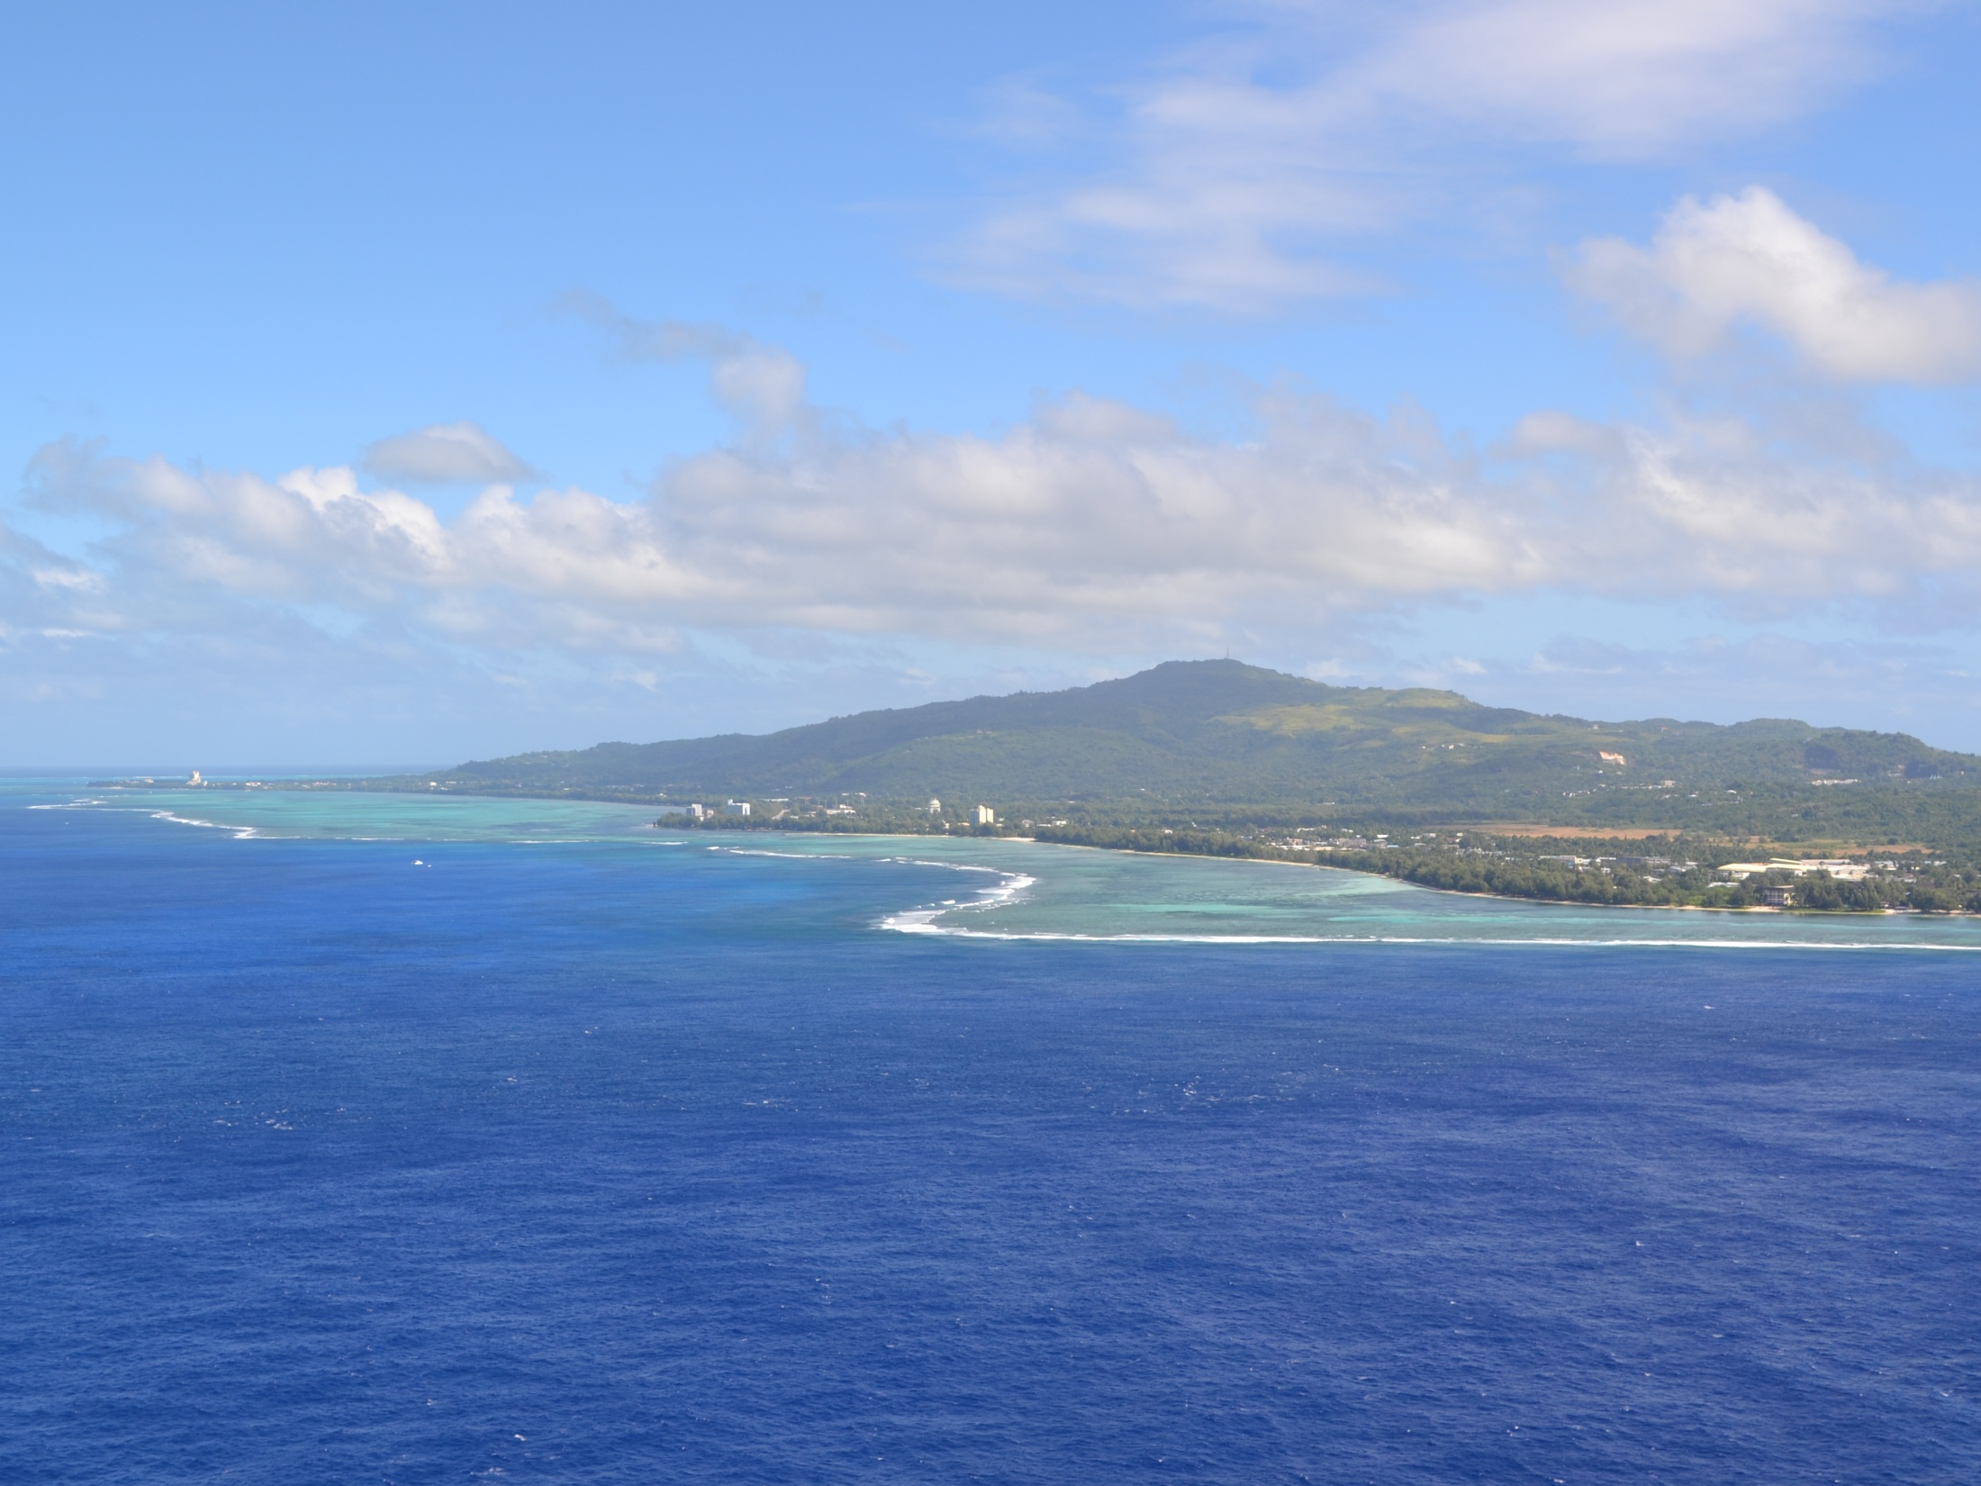
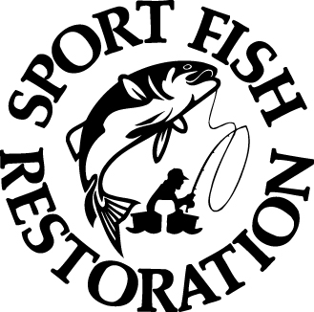
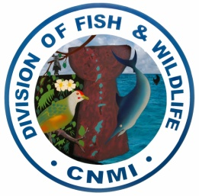
The Commonwealth of the Northern Mariana Islands’
Division of Fish & Wildlife FAD PROGRAM
Frank Villagomez
APASEEM Annual Science Conference
American Memorial Park Auditorium, Saipan, CNMI
November 19-21, 2013
Notes:
Hafa adai, my name is Frank Villagomez. I run the Fish Aggregating Device Program for the Division of Fish and Wildlife. Tonight I will be talking about

Slide 2
Brief Overview
CNMI FAD Program
What are FADs?
FAD History
CNMI FADs
How do they work?
Pelagic Fisheries
Pros & Cons
Issues and Future of FAD Program
Notes:
What is the CNMI FAD Program? The FAD Program or Fish Aggregating Device Program is intended to help fishermen catch more fish with less effort so that recreational activities such as Sports Fishing are enhanced.

Slide 3
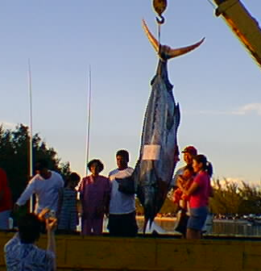
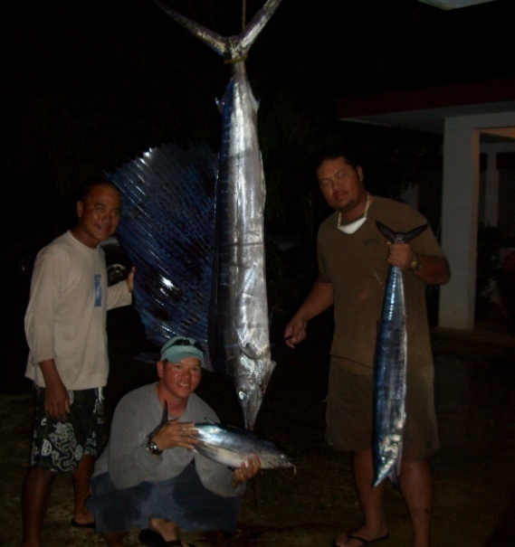
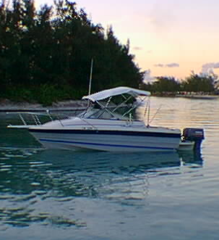
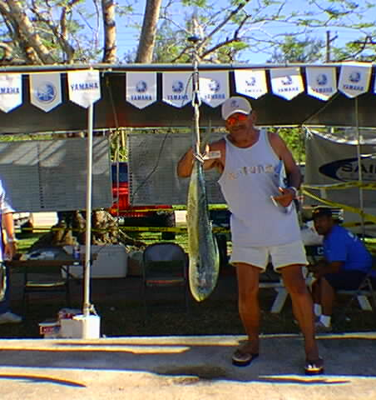
Purpose of FAD Program
To promote pelagic recreational fishing by providing fishermen with a cost effective way of catching pelagic fish in the CNMI. Also to promote pelagic recreational fishing.
Notes:
What is the CNMI FAD Program? The FAD Program or Fish Aggregating Device Program is intended to help fishermen catch more fish with less effort so that recreational activities such as Sports Fishing are enhanced.

Slide 4
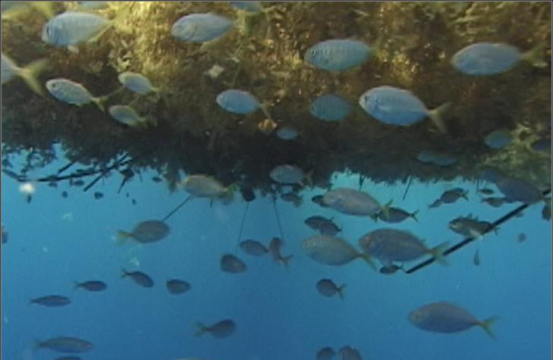
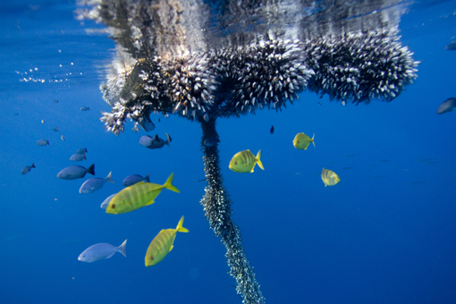
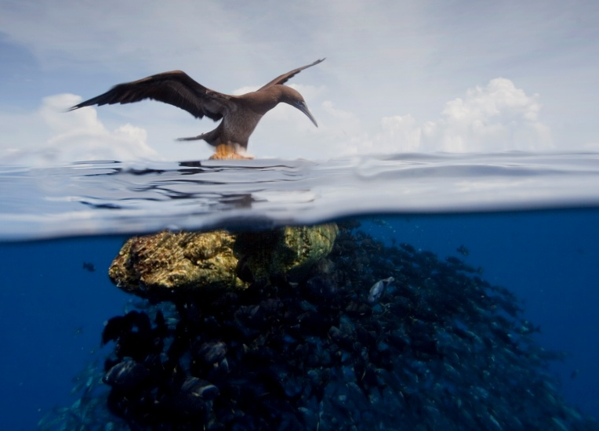
What are FADs?
Fish Aggregating Devices or FADs are generally floating logs or other drifting objects that attract fish around them
Notes:
When my friends and family ask me what it is I do, I tell them that I run the FAD Program. Then they ask me, “Well, what is a FAD exactly?” The easiest way for me to explain it is that they are GENERALLY FLOATING OR DRIFTING OBJECTS THAT ATTRACT FISH AROUND THEM.
It was observed by fishermen that they had higher catches of oceanic fishes such as tuna when they found these drifting objects and fished near them than when they fished in open ocean

Slide 5
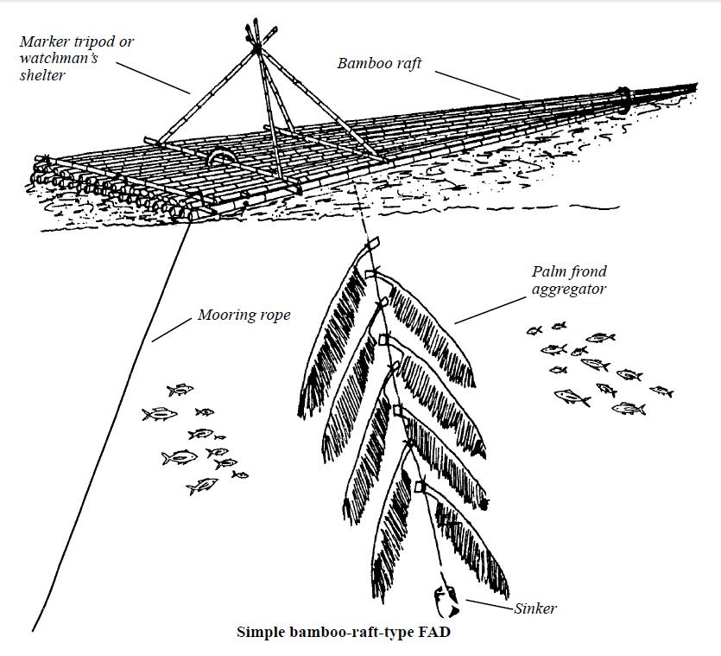
FAD HISTORY
In the early 1900s, fishermen in Indonesia and the Philippines began building floating rafts of bamboo and other materials to attract schools of fish (Anderson & Gates 1996)
Modern Fish Aggregating Devices are derived from traditional Filipino aggregating system called the Payao.
Notes:
Fishermen used this to their benefit and “IN THE EARLY 1900S, FISHERS FROM INDONESIA AND PHILIPPIHNES BEGAN BUILDING PERMANENT FLOATING STRUCTURES OR RAFTS OUT OF BAMBOO TO ATTRACT FISH.
Today, MODERN FISH AGGREGATING DEVICES ARE DERIVED FROM TRADITIONAL FILIPPINO AGGREGATING SYSTEMS CALLED PAYAO

Slide 6
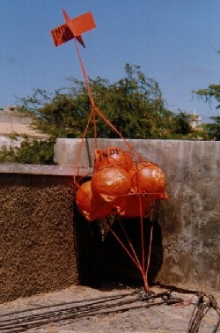
FAD HISTORY
Modifications were made to enable FADS to withstand the forces of the open ocean.
  Monofilament lines
  Fiber glass buoys
  Chains
  Lighting
Other modifications were developed to enhance the productivity of FADS.
Notes:
Fishermen or fisheries managers continued to make modifications to prolong its lifespan since most FADs have a short life and they wanted to make it more cost efficient so they used rope with higher breaking strengths and floating objects that were less vulnerable to the elements.

Slide 7
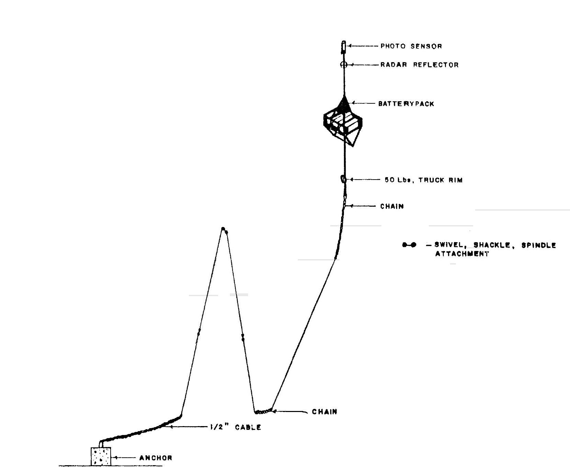
FADs in the CNMI
The Pacific Tuna Development Foundation
  Deployed 5 FADs at leeward side in the spring of 1980
  3-drum NMFS design
  2 near Saipan
  2 near Tinian
  1 near Rota
Notes:
In the SPRING OF 1980, THE PACIFIC TUNA DEVELOPMENT FOUNDATION BASED OUT OF HAWAII DEPLOYED SEVERAL FADS OFF THE LEEWARD SIDE OF SAIPAN, TINIAN, AND ROTA USING 3 foam filled 55 gal drums encased in an iron frame
----- Meeting Notes (2/12/13 23:33) -----
In the past the CNMI through the PTDF out Hawaii

Slide 8
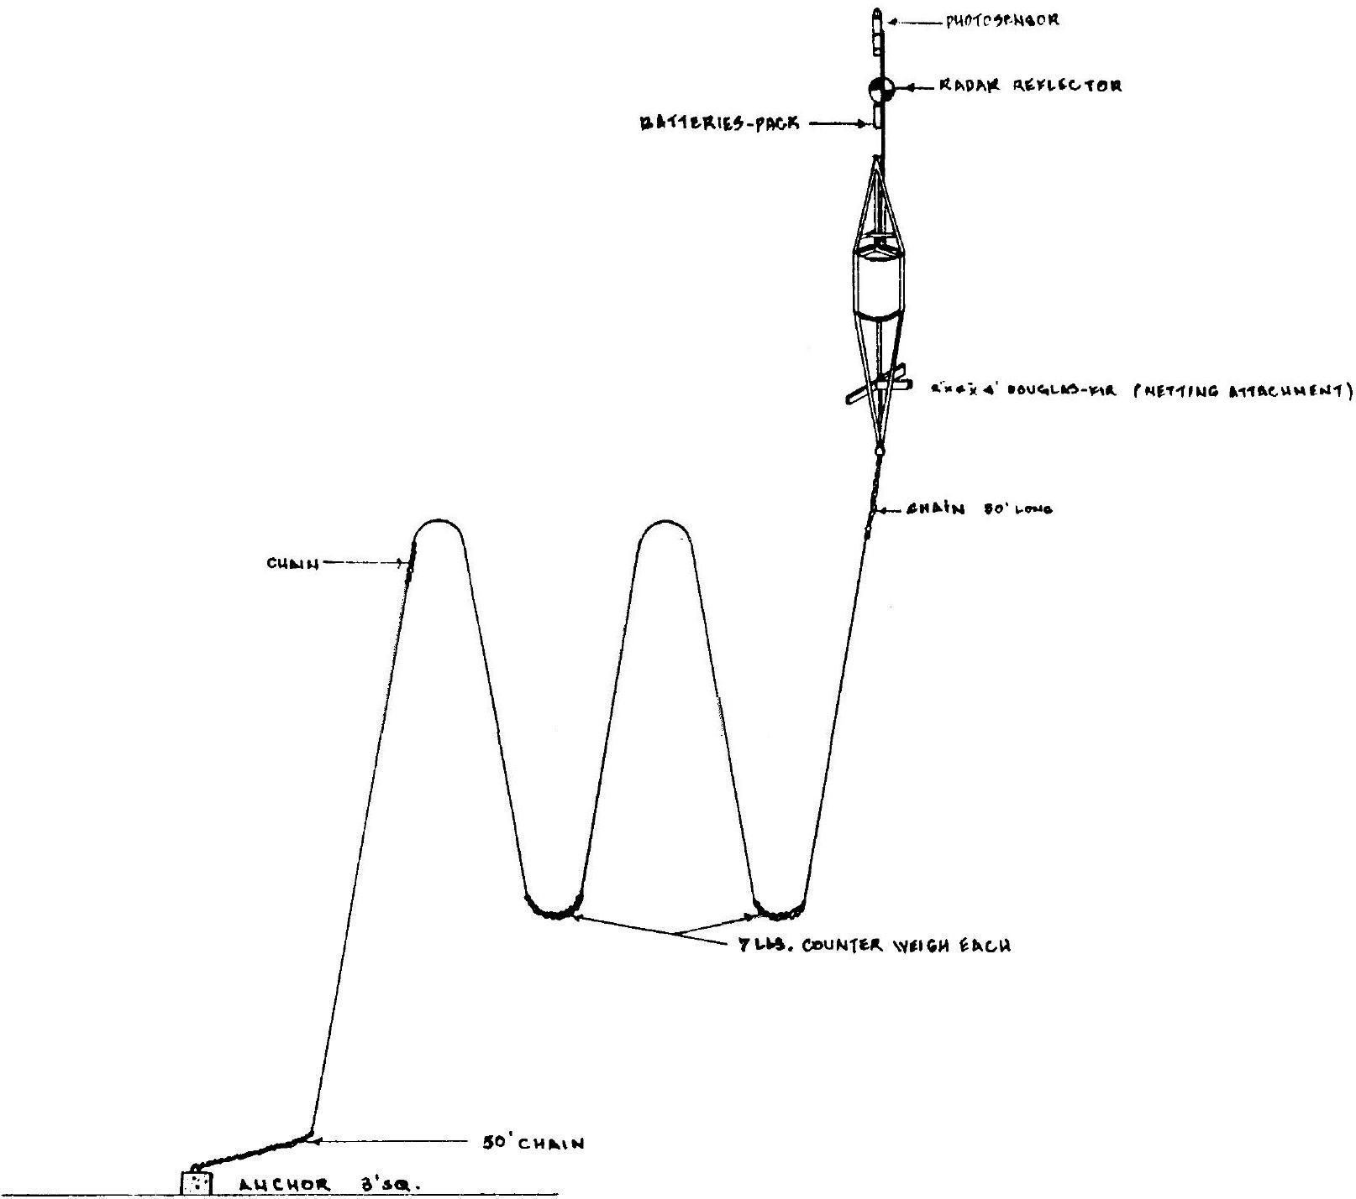
FADs in the CNMI
  All lost within 2 - 5 months
  1-drum design after loss
Notes:
AFTER A FEW MONTHS, ALL WERE LOST. THEN A MORE STREAMLINED DESIGN LIKE THIS 1-DRUM DESIGN WAS USED THEREAFTER.
----- Meeting Notes (2/12/13 23:33) -----
It was reported that this deployment did not have a working depth finder and deployed this FAD in shallower water than expected

Slide 9
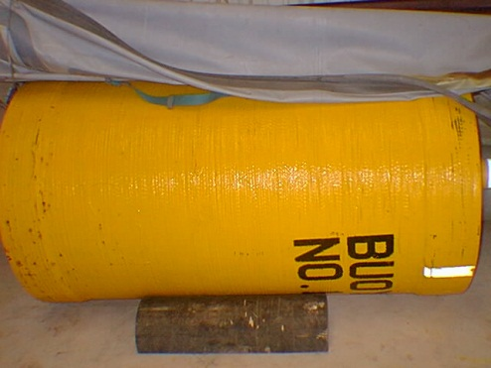
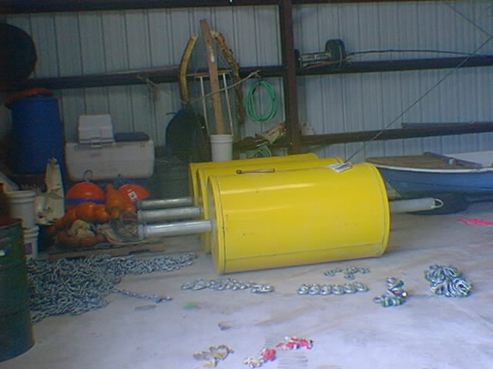
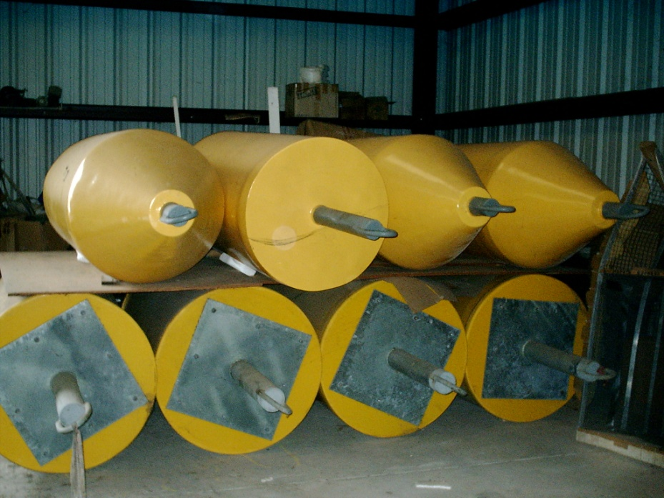
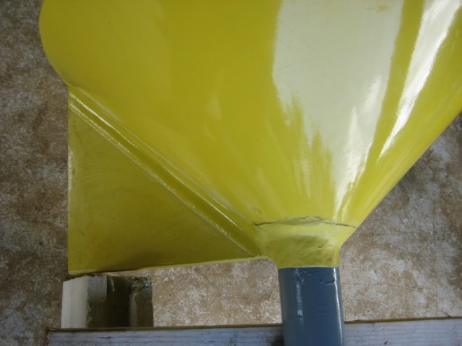
FADs in the CNMI
Notes:
Over the years, DFW continued to increase the number of FADs and replacing lost systems over time. As you can see here on this slide and from the slides before this, the Division has gone through several FAD designs to perfect the system and to increase longevity of each FAD and to decrease the number of incidences of lost FADs.
The buoys were originally steel and have evolved to the lighter cylindrical fiberglass model. Today, our FADs are more conical at the bottom for a more streamline effect to reduce drag and stress to the FAD system. Also, a keel or rudder was added to prevent the FAD from spinning so much which also stresses the upper system of the FAD.

Slide 10
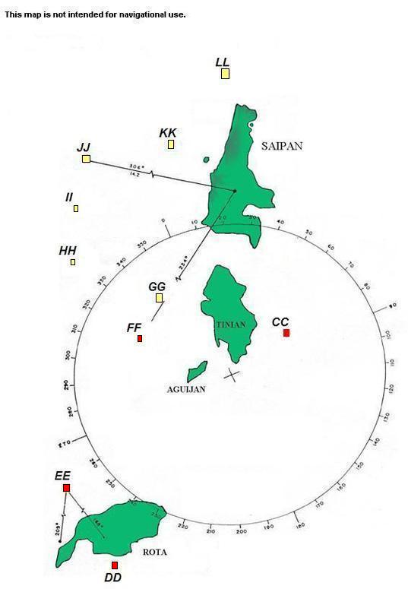
Location of FADs
10 FAD sites
5 to 10 miles from shore
Between 1,000 to 6,000 feet of depth
6 active FADs near Saipan and Tinian
Redeploy FADs to replace inactive sites this fiscal year
Notes:
Today we have 10 permitted FAD site, 5 were newly deployed earlier this year and 1 was in the water for almost 7 years. That information is for the lower system. The buoy and upper chain were exchanged several times for maintenance. These FADS ARE ANYWHERE FROM 5 TO 10 MILES OFF SHORE AND DEPLOYED AT DEPTHS BETWEEN 1000 TO 6000 FEET.
FADS denoted in red will be deployed sometime next year.
FADS LL and KK were redeployed on July 6, 2013. FAD JJ was redeployed on July 8, 2013. FADs II and GG will be redeployed July 10, 2013.

Slide 11
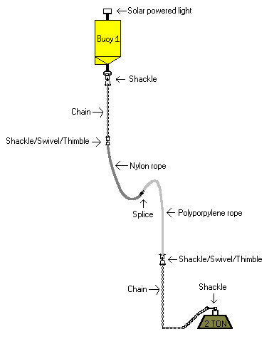
FAD Mooring System
Notes:
This here shows the FAD mooring system as a whole where we have the buoy which is attached to 25 feet of ¾ inch chain, several thousands of feet of a sinking rope and a floating rope attachment, 25 more feet of ¾ inch chain all being anchored down by a 2 ton concrete anchor

Slide 12
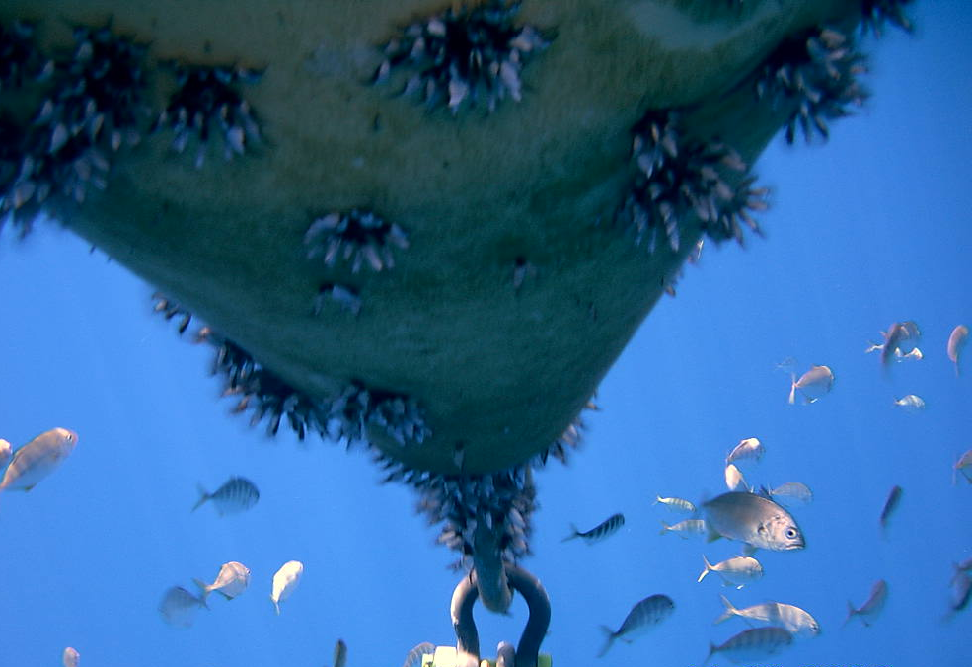
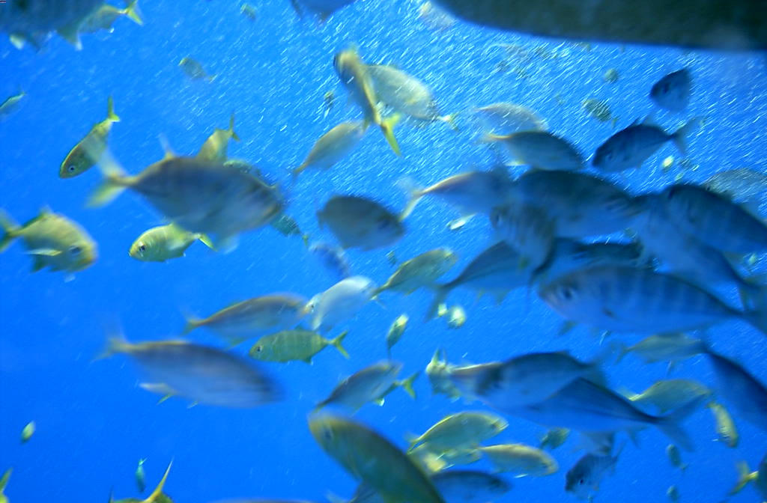
How do FAD Systems Work?
Provides a substrate for algae and barnacles to attach to
The fouling of the FAD system creates an artificial habitat for small fish.
The small fish attract larger fish such as Skipjack tuna, Mahi-mahi, Wahoo and Marlin.
These fish can then be caught at a fixed location. Which means less fuel spent searching for bird flocks.
Notes:
So how do FADs work? Well, they create an oasis in the middle of the ocean, creating an environment for bait fishes and a feeding ground for larger predatory fishes. In other words, an artificial home for pelagic fishes at a fixed location. IF YOU SPENT ANYTIME TROLLING FOR PELAGICS OUT IN THE OCEAN, THIS MEANS LESS FUEL SPENT SEARCHING FOR BIRD FLOCKS.

Slide 13
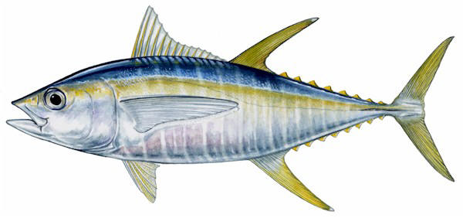
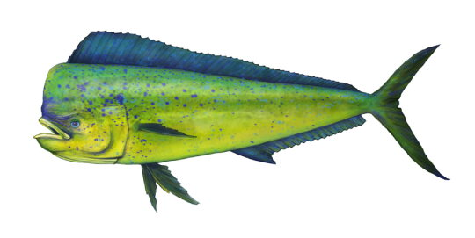
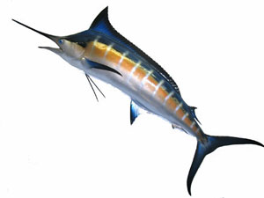
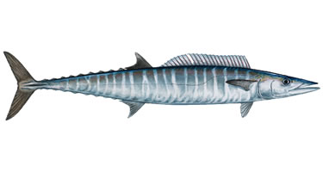
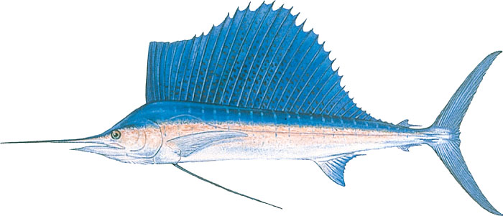
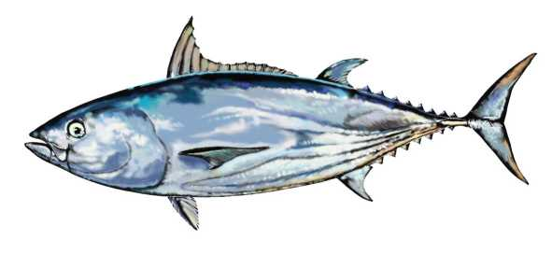
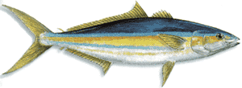
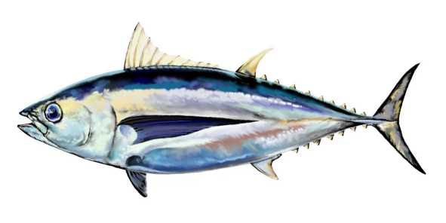
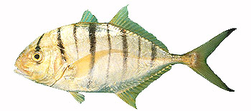

COMMON FISH FOUND AROUND FADS
Notes:
If you don’t spend time out there in the ocean fishing, you probably don’t know what types of fishes you can find. Some common fishes found near fads are skipjack tunas, mahimahi, baitfishes such as bigeye scad to name a few

Slide 14
CNMI Creel Survey 2011 Pelagic Species Composition
Notes:
In 2011, DFW CNMI CREEL PROGRAM REPORTED ON THE SPECIES COMPOSITION OF PELAGIC FISHES. Here the percent species composition is calculated by the total pelagic landings by weight where Skipjack tuna is the highest of pelagic landings at 64%, Mahimahi at 16%, and Yellowfin Tuna at 12%. There was a total Pelagic landing of 350,216 lbs for 2011
DFW Data: Reported on (Pelagic Fisheries of the Western Pacific Region 2011 Annual Report)

Slide 15
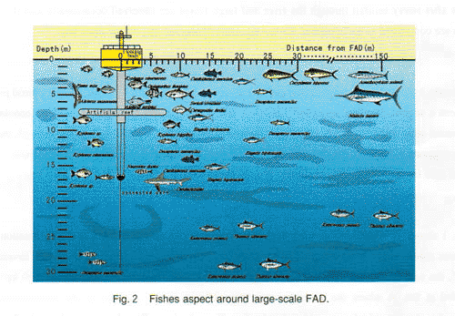
Are fish all at the top?
Notes:
FADs aggregate different fish at different depths. Small tunas are usually found schooling near the surface. Larger yellowfin, bigeye and albacore tunas generally gather near FADs at depths between 50 m and 300 m, although they can also be found closer to the surface at times, especially at night. Other fish species, including rainbow runner, mahi-mahi, sharks and billfish are also commonly attracted to FADs.

Slide 16
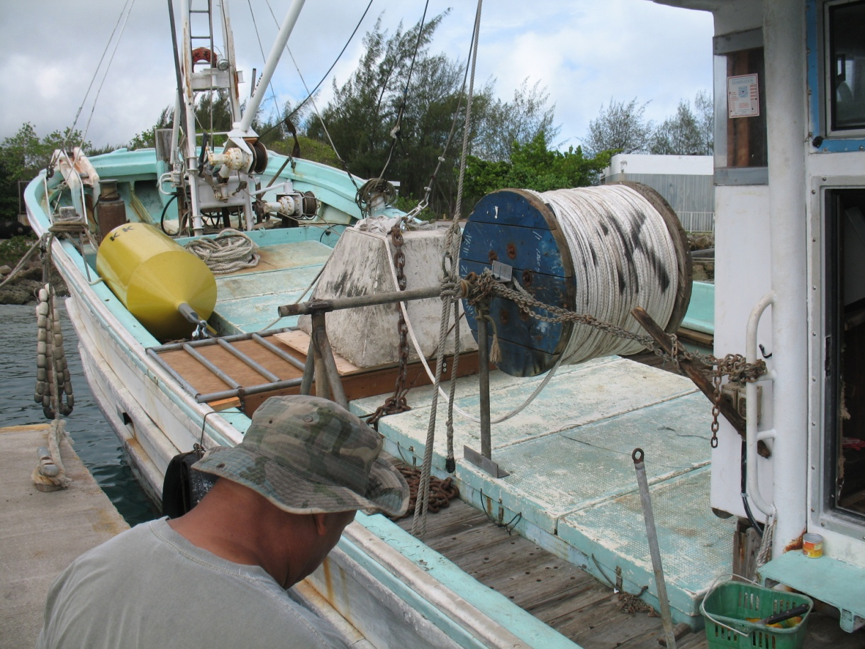
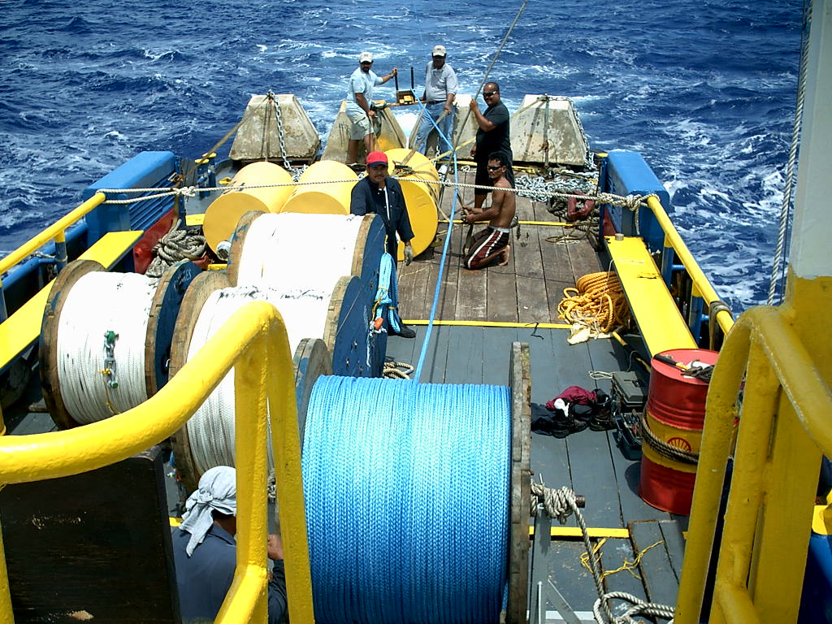
Deployment of FADs
Notes:
How do we deploy these big and heavy system? Well, over the years Various vessels have been used to deploy FADs.
Anchors are deployed off of large vessels to minimize danger.

Slide 17

Video
Notes:
I have videos here to show you how these systems are deployed. When the vessel arrives at the marked location for the fad, the buoy is then tossed overboard and the line is paid out. This continues on then the anchor is released

Slide 18
Notes:
Play movie

Slide 19
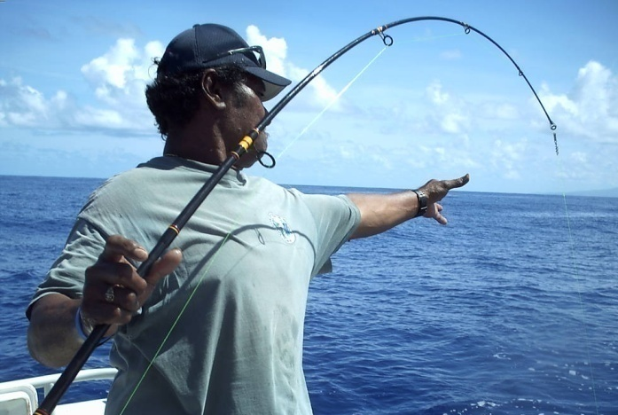
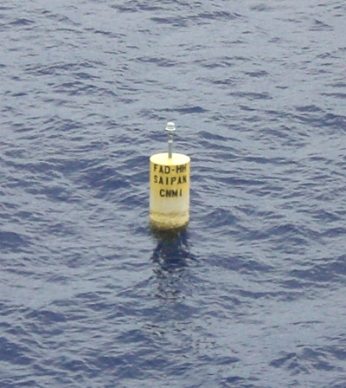
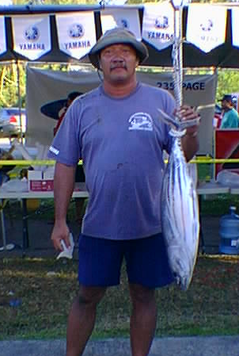
BENEFITS OF FADS
A SET LOCATION FOR TROLL FISHING
HIGHER PROBABILITY OF CATCHING A FISH
VERY ECONOMICAL FOR FISHERMEN
LESS TIME SPENT ON SEARCHING FOR SCHOOLS OF FISH
SAFETY FOR SMALL BOAT FISHERS
Notes:
Why fish at FADs? It Reduces fishing pressure on reef resources, it is a set location for troll fishing, there is a higher probability of catching a fish vs non fad-fishing, it’s economical for recreational fishermen, and it reduces Fuel consumption

Slide 20
CONS OF FADS
HIGH LOSS RATE
  2 to 4 units are lost within the first year.
HIGH UNIT COST
  Average cost per unit is $7000.
SHORT LIFE SPAN
  1 to 2 years
Notes:
The cons of fads are the high loss rate of fads sometime 2 to 4 fads are lost within the first year, it’s expensive where the average cost per system is $7000, and it has a short average lifespan of 1 to 2 years. The program would be lucky to have a fad that lasts 3 years.

Slide 21
Issues, problems, and concerns
Dependence on imported materials contributes to the high cost of services and products.
The construction of FADs requires materials that are not readily available in the CNMI.
The CNMI has few vendors who are able to offer services for the procurement of FAD materials.
Deployment costs continue to increase each year. Companies who are familiar with the deployment process increased their prices. In contrast newer companies who aren’t familiar with the deployment process bid low which can force the program to award the cheaper, unskilled company; in the past this resulted in a few lost FADs.
Notes:
The CNMI is dependent on external products, with a majority of its materials being imported. It’s location within the region also contributes to the significantly high cost of services and products. Increases in shipping costs ultimately results in increased costs to the consumers. The construction of FADs requires materials that are not readily available in the CNMI. As a result, most of the materials needed for the construction of FADs are ordered from off-island. The CNMI has few vendors who are able to offer services for the procurement of FAD materials. Additionally a majority of them are limited in their abilities to perform the tasks required by the project. The services these vendors offer are usually costly, which consequently forces us to explore services outside the CNMI. A pressing issue in the CNMI is that government payments have been a sluggish, prolonged process which has resulted in many of the vendors being reluctant to offer services to government entities. Additionally, it has also led to the increase in service costs to cover the time it takes for the government to pay its obligations. (DFW Fisheries Research Section 2011-12 Report)
Another issue with our FADs program is that deployment costs continue to increase each year. Companies who are familiar with the deployment process increased their prices. In contrast newer companies who aren’t familiar with the deployment process bid low which can force the program to award the cheaper, unskilled company; in the past this resulted in a few lost FADs.
To possibly help alleviate the increased costs of deployment, the FRS will continue to research for new buoy designs for prolonged lifespan of FAD systems and remote satellite tracking of FADs. The use of remote monitoring using GPS integrated technology could possibly cut costs for aerial or boat surveys.

Slide 22
Future prospects
To possibly help alleviate the increased costs of deployment, the FRS will continue to research for new buoy designs for prolonged lifespan of FAD systems
To possibly help increase the productivity of a FAD, coconut fronds will be investigated and implemented as additional aggregators
The use of a towed-barge for FAD deployments is currently being investigated to alleviate increasing deployment costs
Notes:
Another issue with our FADs program is that deployment costs continue to increase each year. Companies who are familiar with the deployment process increased their prices. In contrast newer companies who aren’t familiar with the deployment process bid low which can force the program to award the cheaper, unskilled company; in the past this resulted in a few lost FADs.
To possibly help alleviate the increased costs of deployment, the FRS will continue to research for new buoy designs for prolonged lifespan of FAD systems and remote satellite tracking of FADs. The use of remote monitoring using GPS integrated technology could possibly cut costs for aerial or boat surveys.

Slide 23
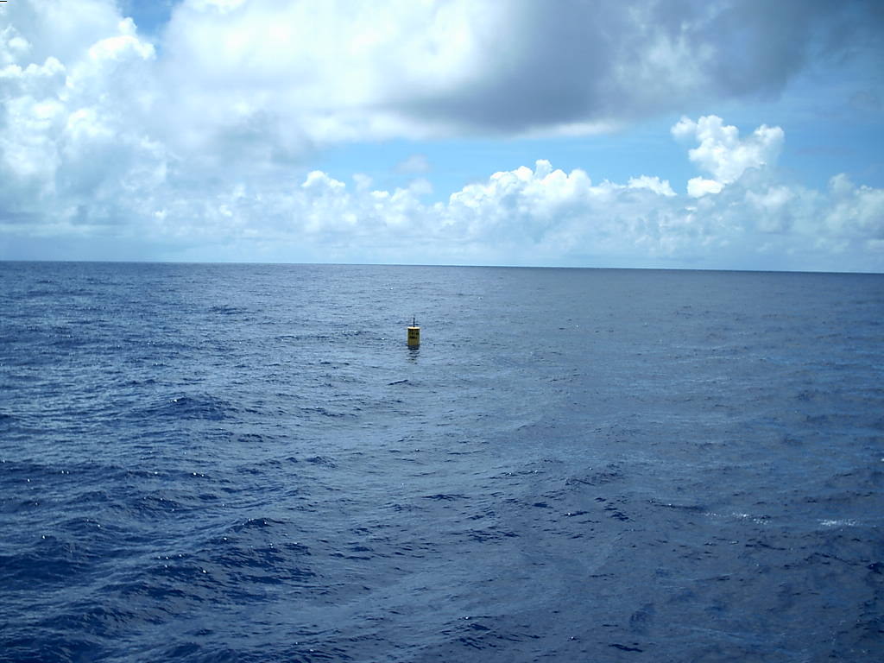
Thank You
For more information on FADs contact Frank Villagomez
Office: (670) 664-6044
Email: fvillagomez.dfw@gmail.com

